Slide 1
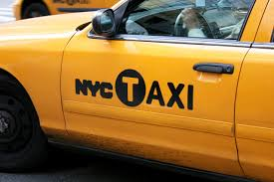
NYC Taxi Fare
A Data-Driven Approach
Presented by
Ishika Goel
(MABSPG23002)

Slide 2
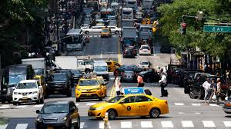
The Taxi Challenge: A Complex Fare Equation
NYC taxis are an integral part of the city's transportation network.
Predicting fares accurately is challenging due to various influencing factors.
This project uses machine learning to develop a robust fare prediction model.

Slide 3
Steps to follow
Splitting the data into training and testing sets.
Training different machine learning models on the training data (e.g., Linear Regression, Random Forest Regression, etc.).
Evaluating the performance of these models on the testing data using metrics like mean squared error or R-squared.
Choosing the best performing model to predict taxi fares for new unseen data.

Slide 4
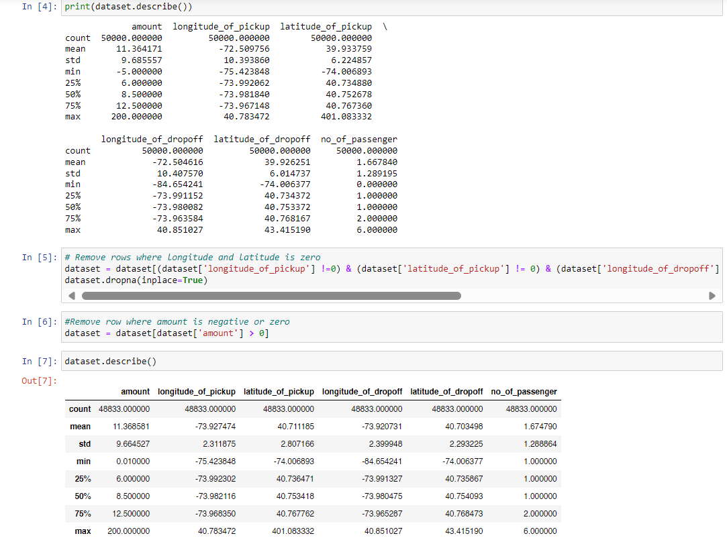
Data Acquisition and Cleaning
Dataset: Taxi_Fare_Dataset.xlsx
Key Features: Pickup/drop-off coordinates, passenger count, pickup datetime, fare amount.

Slide 5
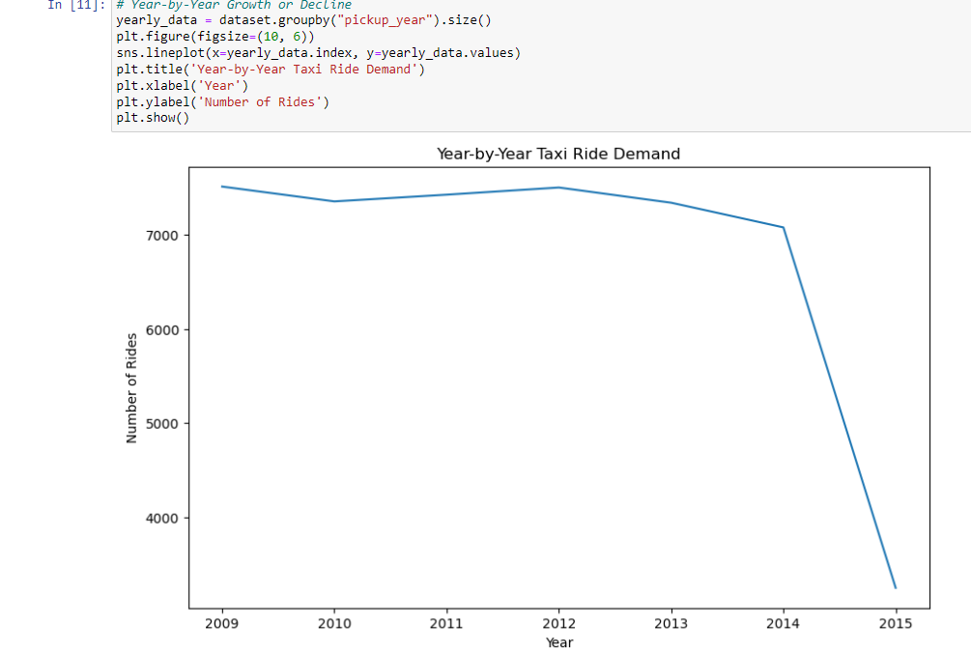
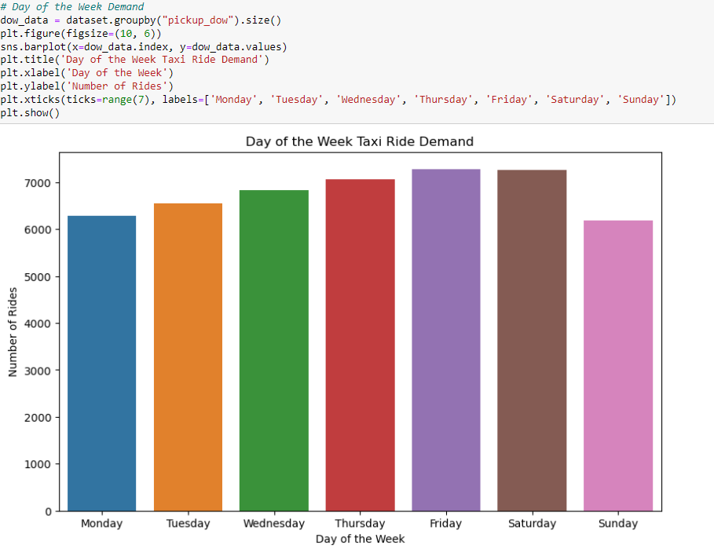
Exploratory Data Analysis (EDA) Understanding Demand Patterns

Slide 6
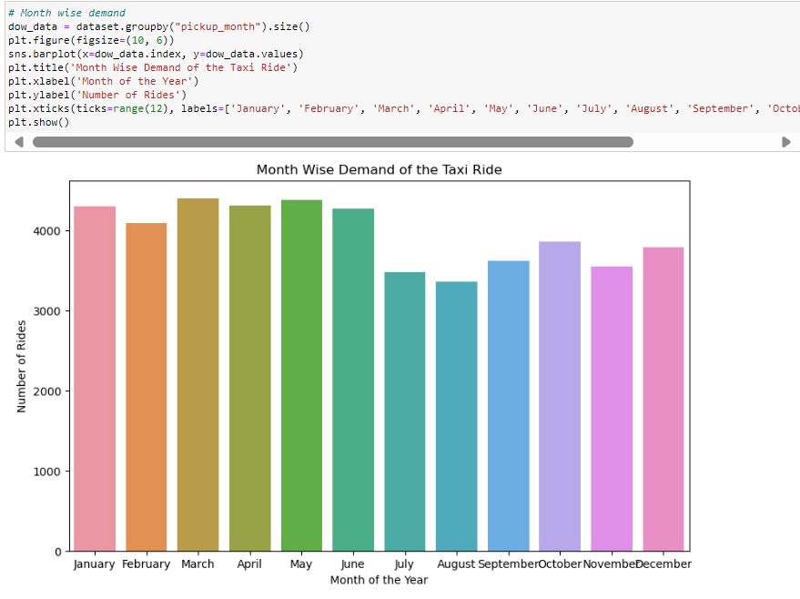
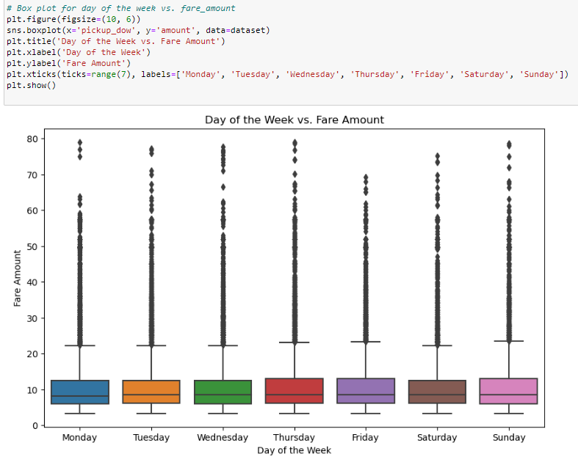
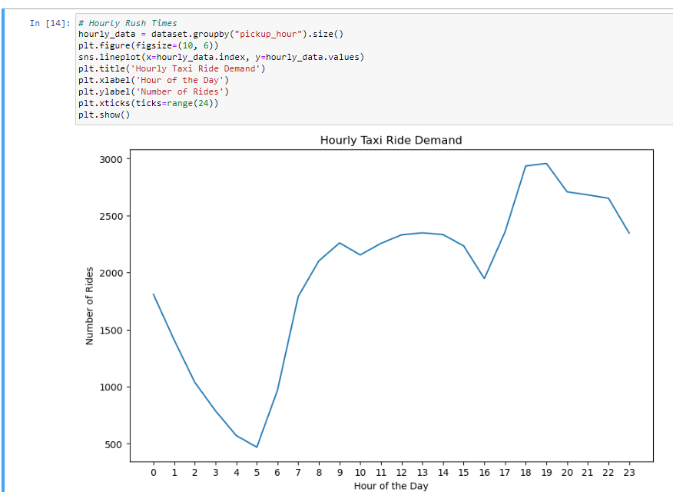
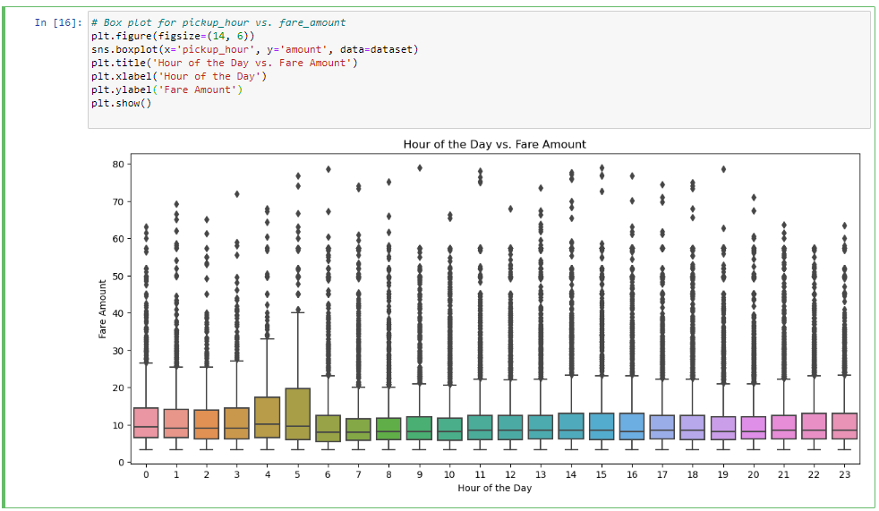
EDA - Time and Fare Dynamics When and How Much?
Seasonal Trends – demand is highest in March and May.
Hourly Patterns – peak hours for taxi rides
Box Plot – shows the fares trends

Slide 7
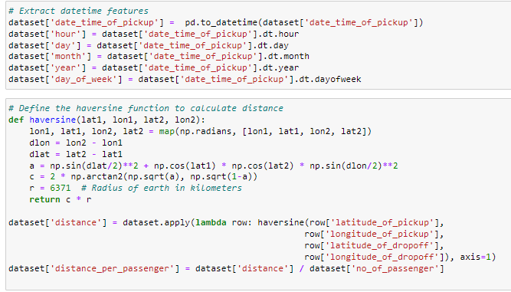
Feature Engineering - Building the Toolkit
Datetime Features: Extracted hour, day, month, year, and day_of_week from the date_time_of_pickup column using .dt accessors.
Distance: Calculated using the Haversine formula to determine the great-circle distance between pickup and drop-off coordinates. This accounts for the curvature of the Earth and provides a more accurate distance than simple Euclidean distance.
Distance per Passenger: Calculated distance / no_of_passenger to account for shared rides, where the fare might be split.

Slide 8
Model Selection and Training
Models Used:
Linear Regression: A simple linear model as a baseline.
Decision Tree Regressor: A tree-based model that can capture non-linear relationships.
Random Forest Regressor: An ensemble of decision trees, which often provides higher
accuracy and robustness.
Training:
Each model was trained on the training data (X_train, y_train).
Features used for training:
longitude_of_pickup, latitude_of_pickup, longitude_of_dropoff, latitude_of_dropoff, no_of_passenger, hour, day, month, year, day_of_week, distance.
Target Variable: amount.
Data Split: 80% training, 20% testing using train_test_split with random_state=42 for consistent results.

Slide 9
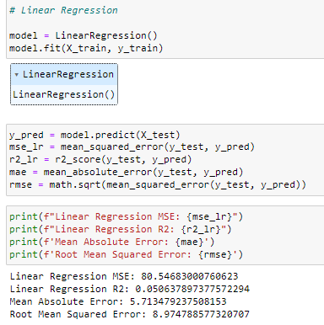
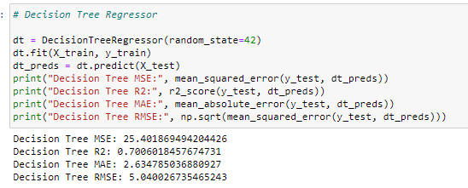
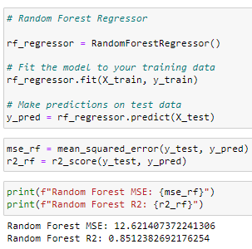
Model Evaluation
“The Random Forest Model performed is best, that indicates superior predictive performance."

Slide 10
Key Insights and Recommendations
Time of day, day of week, and distance are the strongest predictors of taxi fares.
Our model (Random Forest) can accurately predict fares with a high degree of confidence.
Feature engineering significantly improved model performance.
For Drivers: Maximize earnings by focusing on peak hours and high-demand areas.
For Companies: Optimize dispatching and pricing strategies based on real-time demand.
For passengers: Provide fare estimates for better budgeting.
For city planners: Use demand patterns for resource allocation.

Slide 11
Thank You ☺

